Slide 1
Antifungal Drugs
The most common mode of action for antifungal drugs is the disruption of the cell membrane.
Antifungals take advantage of small differences between fungi and humans in the biochemical pathways that synthesize sterols.
The sterols are important in maintaining proper membrane fluidity and, hence, proper function of the cell membrane.
For most fungi, the predominant membrane sterol is ergosterol.
Because human cell membranes use cholesterol, instead of ergosterol, antifungal drugs that target ergosterol synthesis are selectively toxic

Slide 2
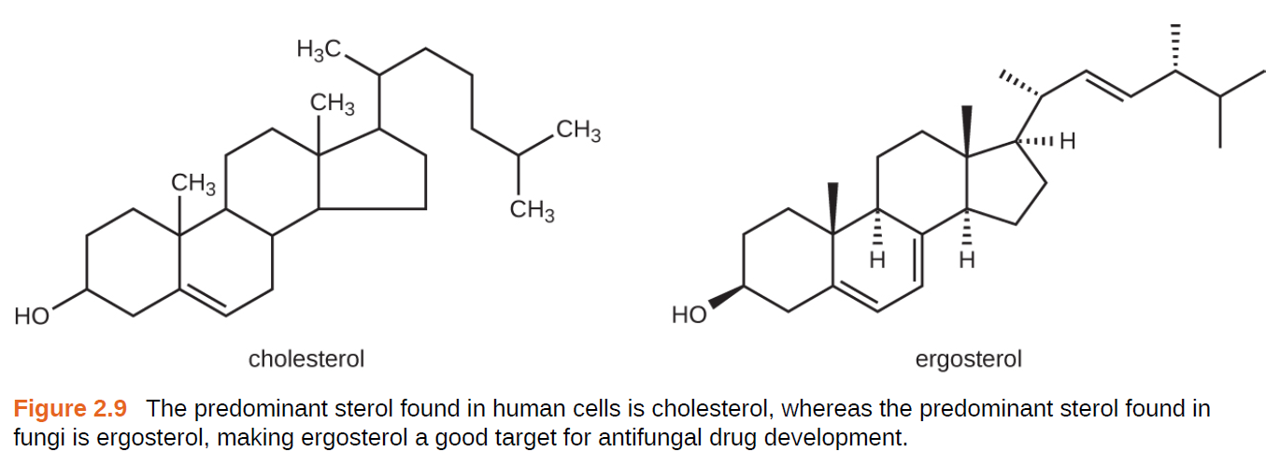

Slide 3
The imidazoles are synthetic fungicides that disrupt ergosterol biosynthesis; they are commonly used in medical applications and also in agriculture to keep seeds and harvested crops from molding.
Examples include miconazole, ketoconazole, and clotrimazole, which are used to treat fungal skin infections such as ringworm, specifically tinea pedis (athlete’s foot), tinea cruris (jock itch), and tinea corporis.
These infections are commonly caused by dermatophytes of the genera Trichophyton, Epidermophyton, and Microsporum.
Miconazole is also used predominantly for the treatment of vaginal yeast infections caused by the fungus Candida, and ketoconazole is used for the treatment of tinea versicolor and dandruff, which both can be caused by the fungus Malassezia.

Slide 4
The triazole drugs, including fluconazole, also inhibit ergosterol biosynthesis.
However, they can be administered orally or intravenously for the treatment of several types of systemic yeast infections, including oral thrush and cryptococcal meningitis, both of which are prevalent in patients with AIDS.
The triazoles also exhibit more selective toxicity, compared with the imidazoles, and are associated with fewer side effects.

Slide 5
The allylamines, a structurally different class of synthetic antifungal drugs, inhibit an earlier step in ergosterol biosynthesis.
The most commonly used allylamine is terbinafine (marketed under the brand name Lamisil), which is used topically for the treatment of dermatophytic skin infections like athlete’s foot, ringworm, and jock itch.
Oral treatment with terbinafine is also used for the treatment of fingernail and toenail fungus, but it can be associated with the rare side effect of hepatotoxicity.

Slide 6
The polyenes are a class of antifungal agents naturally produced by certain actinomycete soil bacteria and are structurally related to macrolides.
These large, lipophilic molecules bind to ergosterol in fungal cytoplasmic membranes, thus creating pores.
Common examples include nystatin and amphotericin B.
Nystatin is typically used as a topical treatment for yeast infections of the skin, mouth, and vagina, but may also be used for intestinal fungal infections.

Slide 7
The drug amphotericin B is used for systemic fungal infections like aspergillosis, cryptococcal meningitis, histoplasmosis, blastomycosis, and candidiasis.
Amphotericin B was the only antifungal drug available for several decades, but its use is associated with some serious side effects, including nephrotoxicity (kidney toxicity).
Amphotericin B is often used in combination with flucytosine, a fluorinated pyrimidine analog that is converted by a fungal-specific enzyme into a toxic product that interferes with both DNA replication and protein synthesis in fungi.
Flucytosine is also associated with hepatotoxicity (liver toxicity) and bone marrow depression.

Slide 8
Beyond targeting ergosterol in fungal cell membranes, there are a few antifungal drugs that target other fungal structures.
The echinocandins, including caspofungin, are a group of naturally produced antifungal compounds that block the synthesis of β(1→3) glucan found in fungal cell walls but not found in human cells.
This drug class has the nickname “penicillin for fungi.”
Caspofungin is used for the treatment of aspergillosis as well as systemic yeast infections.

Slide 9
Although chitin is only a minor constituent of fungal cell walls, it is also absent in human cells, making it a selective target.
The polyoxins and nikkomycins are naturally produced antifungals that target chitin synthesis.
Polyoxins are used to control fungi for agricultural purposes, and nikkomycin Z is currently under development for use in humans to treat yeast infections and Valley fever (coccidioidomycosis), a fungal disease prevalent in the southwestern US

Slide 10
The naturally produced antifungal griseofulvin is thought to specifically disrupt fungal cell division by interfering with microtubules involved in spindle formation during mitosis.
It was one of the first antifungals, but its use is associated with hepatotoxicity.
It is typically administered orally to treat various types of dermatophytic skin infections when other topical antifungal treatments are ineffective.

Slide 11
There are a few drugs that act as antimetabolites against fungal processes.
For example, atovaquone, a representative of the naphthoquinone drug class, is a semisynthetic antimetabolite for fungal and protozoal versions of a mitochondrial cytochrome important in electron transport.
Structurally, it is an analog of coenzyme Q, with which it competes for electron binding.
It is particularly useful for the treatment of Pneumocystis pneumonia caused by Pneumocystis jirovecii.
The antibacterial sulfamethoxazole-trimethoprim combination also acts as an antimetabolite against P. jirovecii.

Slide 13
